Slide 1


Control and integration of renewable resources into the microgrid
Von Pursley
Mentor: Dr. Ricardo Sanfelice
University of Arizona
April 11, 2012

Slide 2
DEMAND FOR RENEWABLE ENERGY
Converting solar energy currently is not very efficient
Currently its efficiency is about 40%
Need for optimizing amount collected

Slide 3
SUN TRACKING SOLAR ENERGY COLLECTORS
sun tracking algorithm interfaced with motors
Two motors: one controls azimuth position and the other controls zenith position

Slide 4
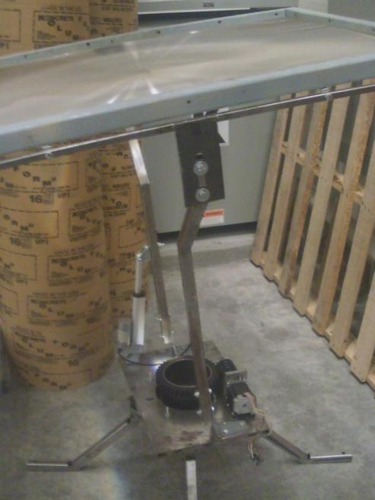

Slide 5
Improvements To Solar Collector
Motor shaft prone to buckling
Motor cannot support thrust loads
Housing needed for motor

Slide 6
USING ENERGY TO COLLECT ENERGY?
Solar collectors rotate very slowly
Torque required to start rotation very low
Net increase in energy collected

Slide 7
TRACKING ALGORITHM
Need to understand how the solar collector is controlled with the algorithm
Clean up and label algorithm so everyone can control collector
Provide instructions on controlling collector and some trouble shooting

Slide 8
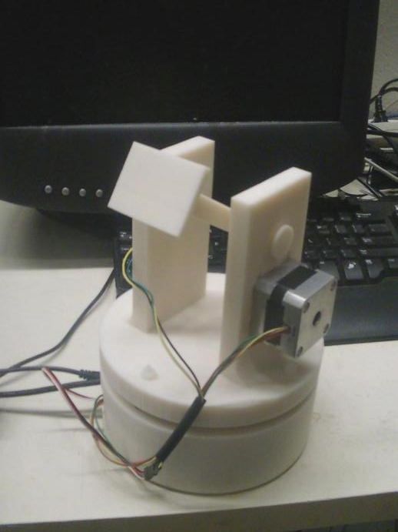

Slide 9
Solar Collector Model
Ideas for improvement
Wires entangling limiting rotation

Slide 10
Impact
Increasing demand for renewable energy with depletion of fossil fuels
Net increase in solar energy collected compared to motionless solar energy collectors

Slide 11
Thank You
With a special thanks to Dr. Sanfelice, my mentor, and my colleagues Nik Kaplan, Matthew Mokler, and Manuel Robles who helped me with my research

